Slide 1
IP addresses and Subnetting

Slide 2
What is IP address?
An IP address is a numeric identity of an interface. Just like a postal address provides a unique identity to a house, an IP address provides a unique identity to an interface.

Slide 3
Why an interface needs unique IP address?
IP network uses IP address to find the destination interface and delivers the IP packets. In order to receive IP packets, an interface needs a unique IP address. If multiple interfaces have same IP address, IP network will not work.
Let’s understand it with an example. In a city all houses have same house number, suppose 195. If there is mail for house number 195, how mailman will delivery that mail? To deliver the mail at correct house, postal system needs unique address of that house. Exactly same way, to deliver an IP packet at correct interface, IP network needs a unique IP address of that interface.

Slide 4
IP address format
An IP address is 32 bits in length. These bits are divided in four parts. Each part is known as octets and contains 8 bits.
An IP address can be written in three notations; dotted-decimal, binary and hexadecimal. Among these types, dotted-decimal is the most popular and frequently used method for writing an IP address.
In dotted-decimal notation, each byte (8 bits) of the 32 bits IP address is written in decimal equivalent. The four resulting decimal numbers are separated by a dot and written in a sequence.
10.10.10.10 ,172.168.10.1, 192.168.1.1 and 200.0.0.1 are some examples of IP address in dotted-decimal notation.
An IP address is the combination of network address and host address

Slide 5
Subnet Mask
A Subnet mask is a 32-bit number that masks an IP address, and divides the IP address into network address and host address. Subnet Mask is made by setting network bits to all "1"s and setting host bits to all "0"s.

Slide 6
There are 2 versions of IP addresses.
IPv4 and IPv6
IPv4 has 32-bit address length
IPv6 has 128-bit address length
An example of an IPv4 address is 216.58.216.164
An example of IPv6 address is 2001:0db8:0000:0000:0000:8a2e:0370:7334
The maximum number of IPv4 addresses, which is called its address space, is about 4.3 billion. That is unique addresses are 2³²
A major advantage of IPv6 is that it uses 128 bits of data to store an address, permitting 2¹²⁸ unique addresses, or 340,282,366,920,938,463,463,374,607,431,768,211,456 or 3.4×10³⁸

Slide 7
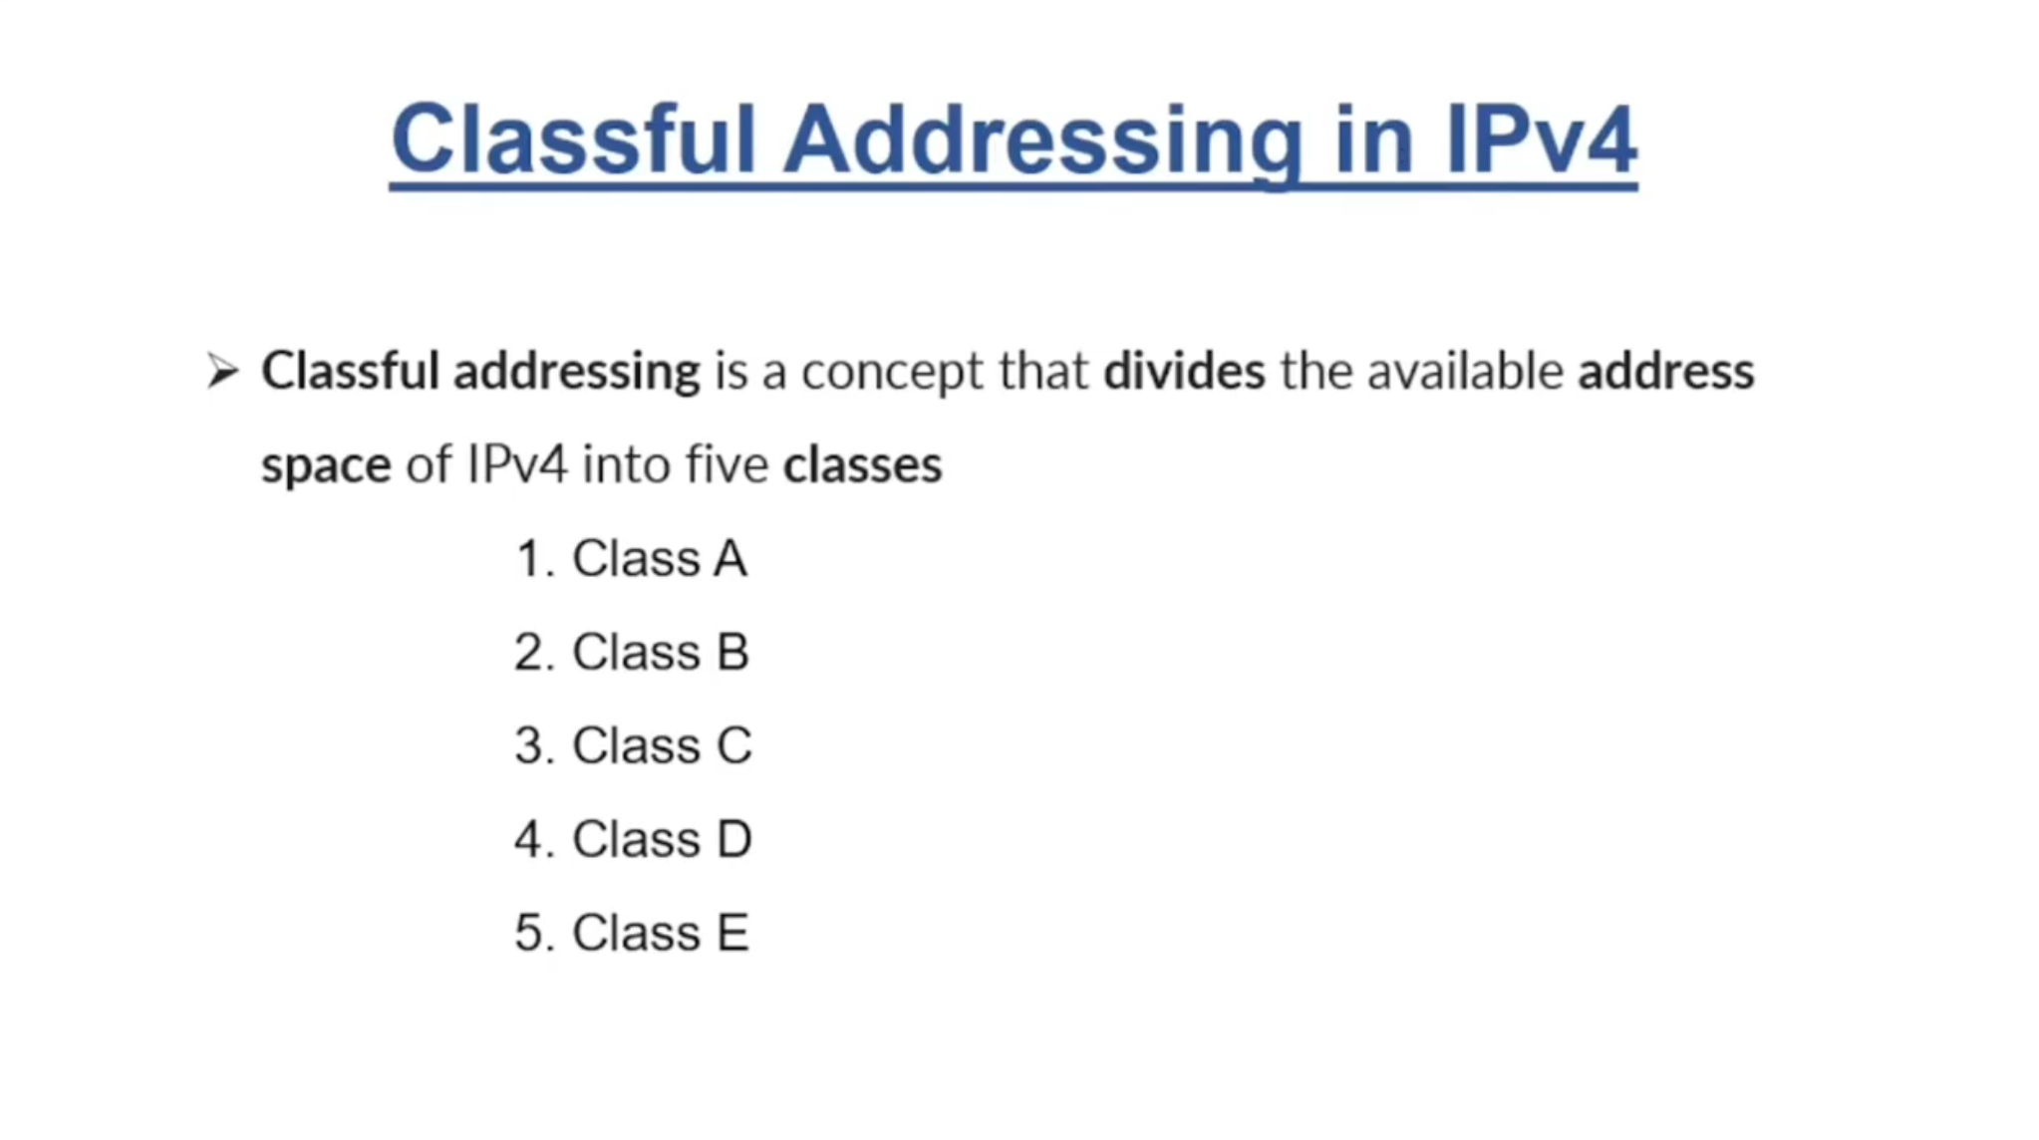

Slide 8
The 32 bit IP address is divided into five sub-classes. These are:
Class A
Class B
Class C
Class D
Class E
IPv4 address is divided into two parts:
Network ID
Host ID
The class of IP address is used to determine the bits used for network ID and host ID and the number of total networks and hosts possible in that particular class.

Slide 9
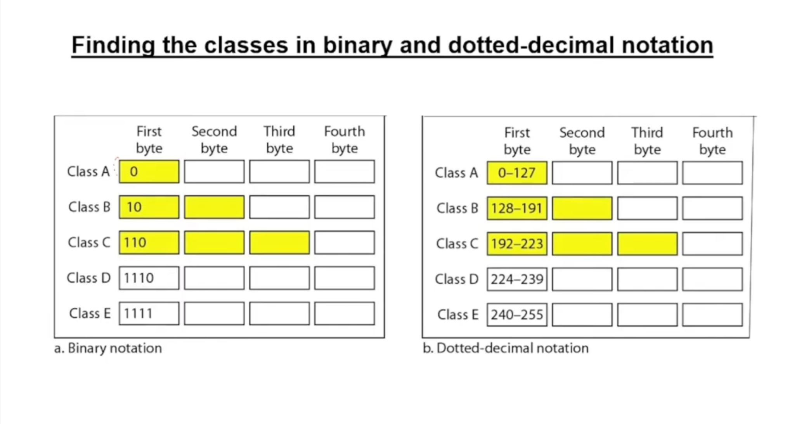

Slide 10
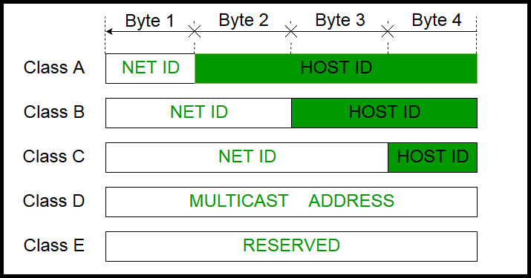

Slide 11
IP address belonging to class A are assigned to the networks that contain a large number of hosts.
The network ID is 8 bits long.
The host ID is 24 bits long.
The higher order bit of the first octet in class A is always set to 0. The remaining 7 bits in first octet are used to determine network ID. The 24 bits of host ID are used to determine the host in any network.
Class A has a total of:
2^7 = 128 network address
2^24 – 2 = 16,777,214 host address
IP addresses belonging to class A ranges from 0.0.x.x – 127.255.x.x.

Slide 12
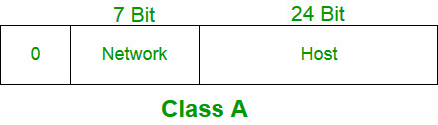

Slide 13
Class B:
IP address belonging to class B are assigned to the networks that ranges from medium-sized to large-sized networks.
The network ID is 16 bits long.
The host ID is 16 bits long.
The higher order bits of the first octet of IP addresses of class B are always set to 10. The remaining 14 bits are used to determine network ID. The 16 bits of host ID is used to determine the host in any network. The default sub-net mask for class B is 255.255.x.x.

Slide 14
Class B has a total of:
2^14 = 16384 network address
2^16 – 2 = 65534 host address
IP addresses belonging to class B ranges from 128.0.x.x – 191.255.x.x.

Slide 15
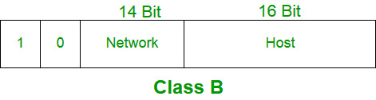

Slide 16
Class C:
IP address belonging to class C are assigned to small-sized networks.
  The network ID is 24 bits long.
  The host ID is 8 bits long.
The higher order bits of the first octet of IP addresses of class C are always set to 110. The remaining 21 bits are used to determine network ID. The 8 bits of host ID is used to determine the host in any network. The default sub-net mask for class C is 255.255.255.x. Class C has a total of:
  2^21 = 2097152 network address
  2^8 – 2 = 254 host address
IP addresses belonging to class C ranges from 192.0.0.x – 223.255.255.x.

Slide 17
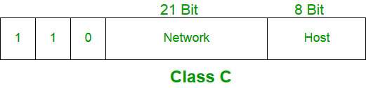

Slide 18
Find the decimal value of 111001₂:
binary number: 1 1 1 0 0 1
power of 2: 2⁵ 2⁴ 2³ 2² 2¹ 2⁰
111001₂ = 1⋅2⁵+1⋅2⁴+1⋅2³+0⋅2²+0⋅2¹+1⋅2⁰ = 57₁₀
Example #2
Find the decimal value of 100011₂:
binary number: 1 0 0 0 1 1
power of 2: 2⁵ 2⁴ 2³ 2² 2¹ 2⁰
100011₂ = 1⋅2⁵+0⋅2⁴+0⋅2³+0⋅2²+1⋅2¹+1⋅2⁰ = 35₁₀

Slide 19
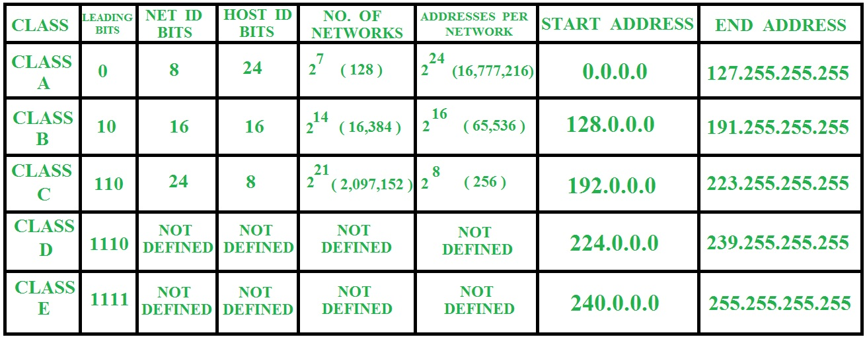

Slide 20
Subnetting
Subnetting is the process of dividing a large network into smaller, more manageable subnets, each with its own IP address range. It's required to improve network performance, enhance security, and efficiently utilize IP addresses.

Slide 21
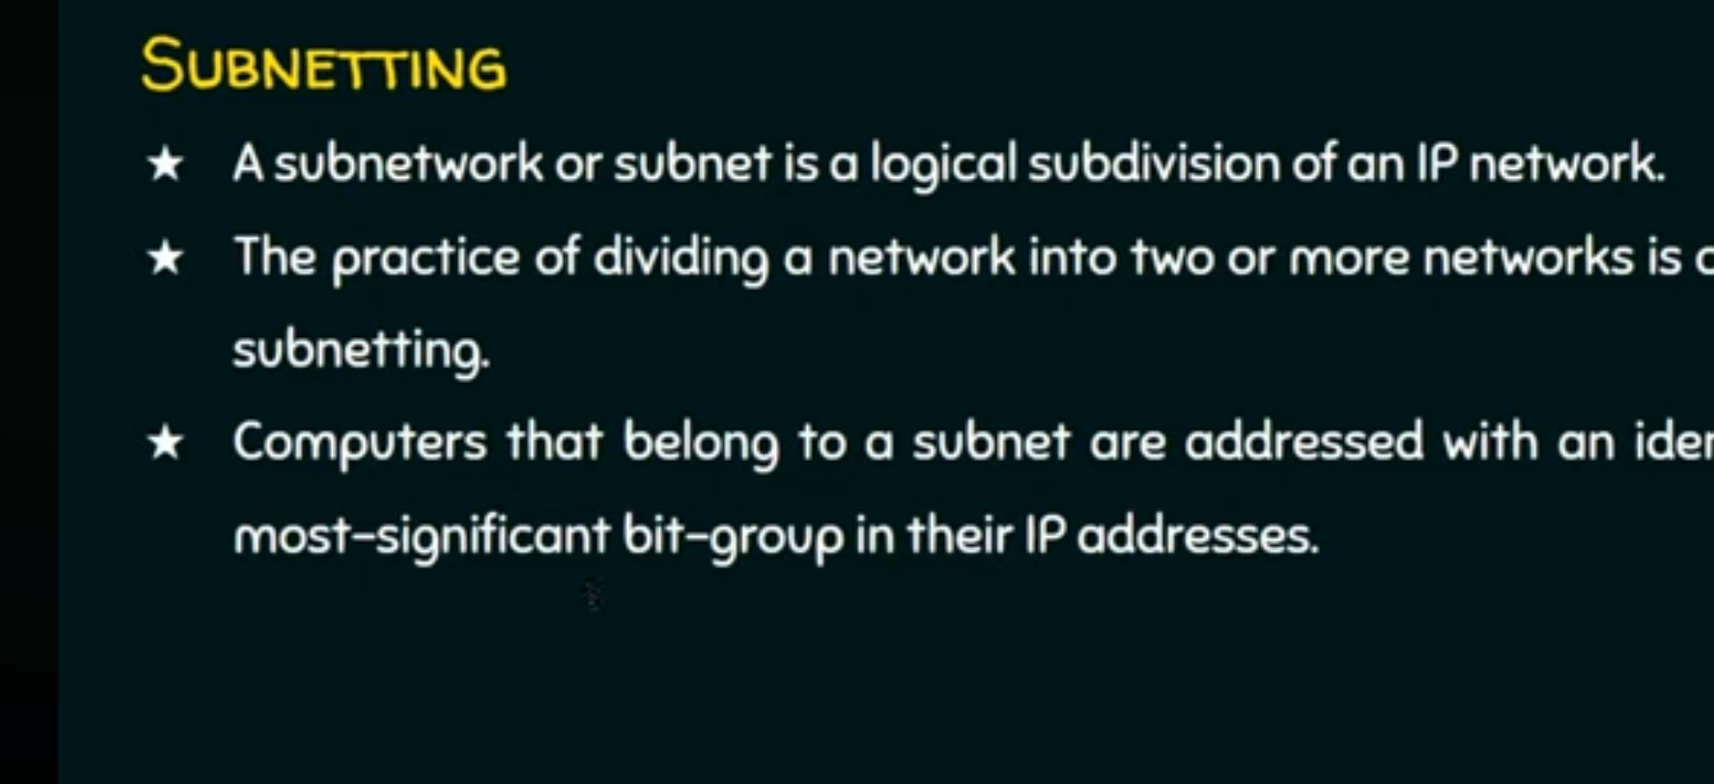

Slide 22
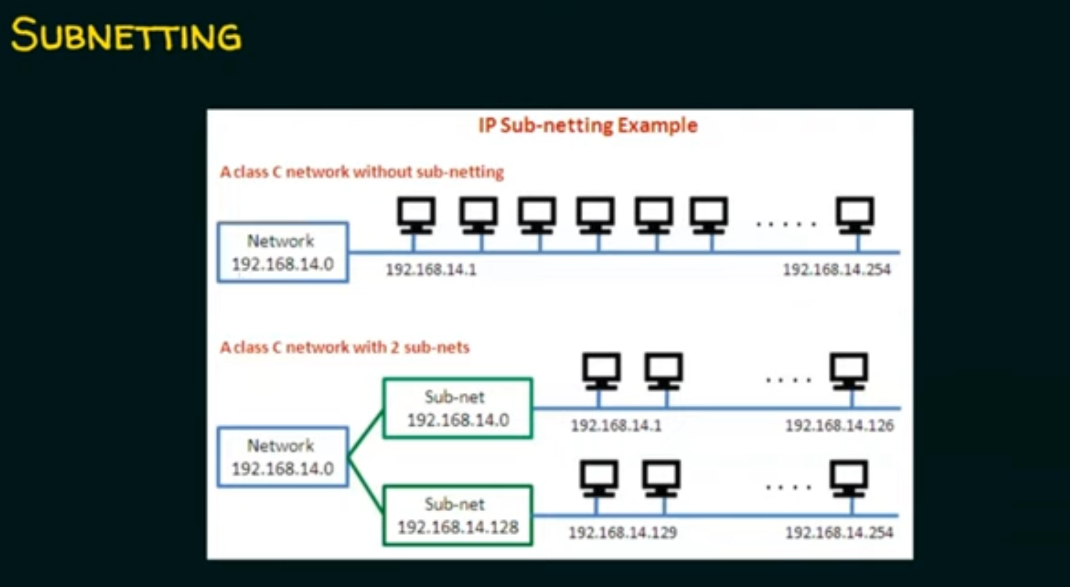

Slide 23
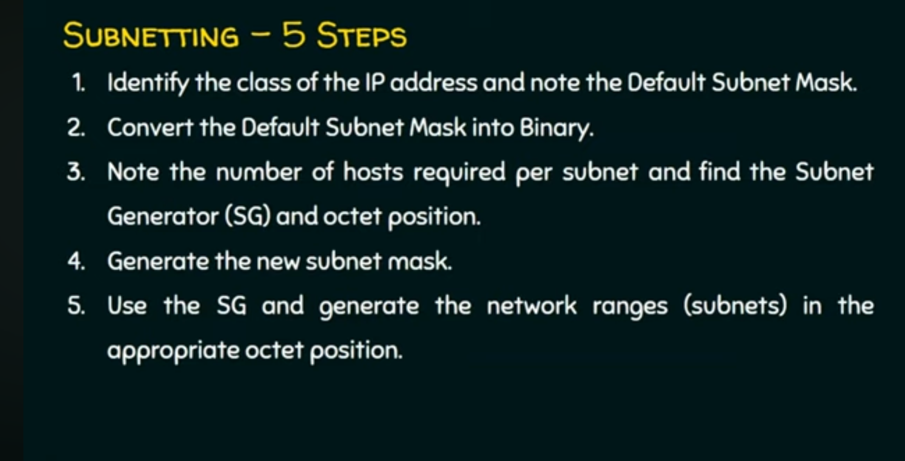

Slide 24
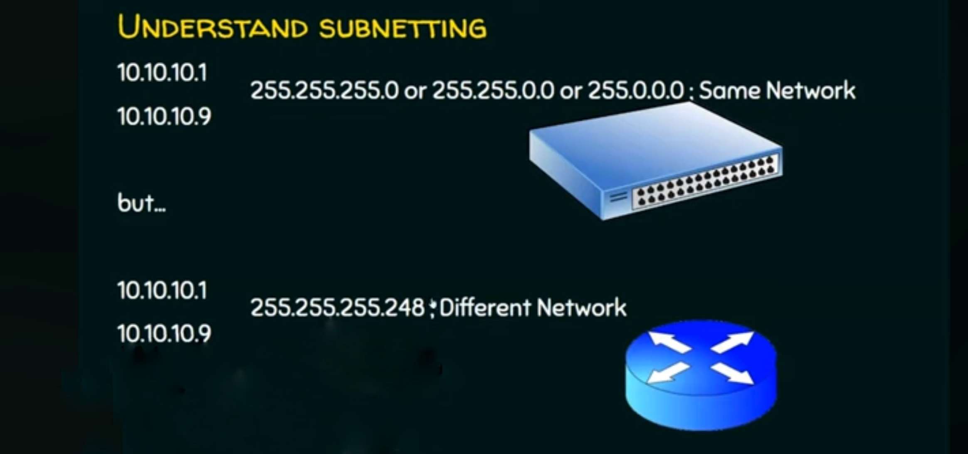

Slide 25
Why Subnetting is Important?
Let’s consider a company that follows classful addressing, it has a Class C network (192.168.1.0/24) with 256 IP addresses. It has three departments:
Sales: 20 devices
HR: 10 devices
IT: 50 devices
Without subnetting, all departments share the same network, and all 256 IP addresses are available to everyone, which leads to:
IP Waste: Only 80 devices are needed (20 + 10 + 50), but all 256 addresses are allocated, wasting 176 addresses.
Performance Issues: Since all departments are on the same network, any data sent between devices floods the entire network, slowing communication for everyone. For example, heavy data transfer in IT can impact Sales and HR.
Security Risks: Without subnets, anyone in Sales can access HR or IT devices, exposing sensitive data like payroll systems.

Slide 26
With Subnetting, we split the network into three subnets, allocating just enough IP addresses for each department:
Sales: 192.168.1.0/27 → 32 IPs (for 20 devices, 12 spare)
HR: 192.168.1.32/28 → 16 IPs (for 10 devices, 6 spare)
IT: 192.168.1.48/26 → 64 IPs (for 50 devices, 14 spare)
By subnetting, we:
Save IP addresses (Efficiency): Only 112 addresses are used (80 + some spare), leaving 144 unused for future growth.
Keep networks faster (Better Performance): Data within each department stays in its subnet. For example, HR traffic stays in HR, reducing network congestion for Sales and IT.
Protect sensitive data (Improved Security): Each department is isolated. If someone in Sales tries to access HR systems, subnet restrictions block them.

Slide 27
What is a Subnet Mask?
A subnet mask is a 32-bit number used in IP addressing to separate the network portion of an IP address from the host portion. It helps computers and devices determine which part of an IP address refers to the network they are present, and which part refers to their specific location or address within that network.
CIDR Notation: A Simplified Approach to Subnetting
Instead of using a long subnet mask (e.g., 255.255.255.0), CIDR uses a simple format like /24. The number after the slash (/n) represents the number of bits used for the network portion of the IP address.

Slide 28
There are two types of Subnetting: FLSM and VLSM. In FLSM, all subnets have an equal number of host addresses and use the same subnet mask. In VLSM, subnets have a flexible number of host addresses. They use a subnet mask based on the number of hosts.
FLSM stands for Fixed Length Subnet Mask. In it, we break the default IP subnet into the same-sized subnets. For example, if the default subnet has 12 IP addresses, we can break it into three equal-sized subnets having 4 IP addresses in each.
VLSM stands for Variable Length Subnet Mask. In it, we break the default IP subnet into subnets having various sizes. For example, if the default subnet has 12 IP addresses, we can break it into two subnets where the first subnet has 8 IP addresses and the second subnet has 4 IP addresses.

Slide 29
Subnet the IP Address 216.21.50.0 into 30 hosts in each subnet.
Steps:
Identify the class of IP Address and find default subnet mask
Class C – 255.255.255.0
Convert default subnet mask into binary
11111111.11111111.11111111.00000000
Note the number of hosts required per subnet and find subnet generator and octet position
No. of Hosts – 30 (11110) 5 bits required
Subnet Generator – 32 (2⁵ )
Octet position – 4th octet
Write the new subnet mask
255.255.255.224/27

Slide 30
Find the range of subnets
  216.21.50.0 – 216.21.50.31
  216.21.50.32 – 216.21.50.63
  216.21.50.64 – 216.21.50.95
  216.21.50.96 – 216.21.50.127
  216.21.50.128 – 216.21.50.159
  216.21.50.160 – 216.21.50.191
  216.21.50.192 – 216.21.50.223
  216.21.50.224 – 216.21.50.255

Slide 31
Subnet the IP Address 196.10.20.0 into 52 hosts in each subnet.
Steps:
Identify the class of IP Address and find default subnet mask
Class C – 255.255.255.0
Convert default subnet mask into binary
11111111.11111111.11111111.00000000
Note the number of hosts required per subnet and find subnet generator and octet position
No. of Hosts – 52 (110100) 6 bits required
Subnet Generator – 64 (2⁶ )
Octet position – 4th octet
Write the new subnet mask
255.255.255.192/26

Slide 32
Find the range of subnets
  196.10.20.0 – 196.10.20.63
  196.10.20.64 – 196.10.20.127
  196.10.20.128 – 196.10.20.191
  196.10.20.192 – 196.10.20.255

